Slide 1
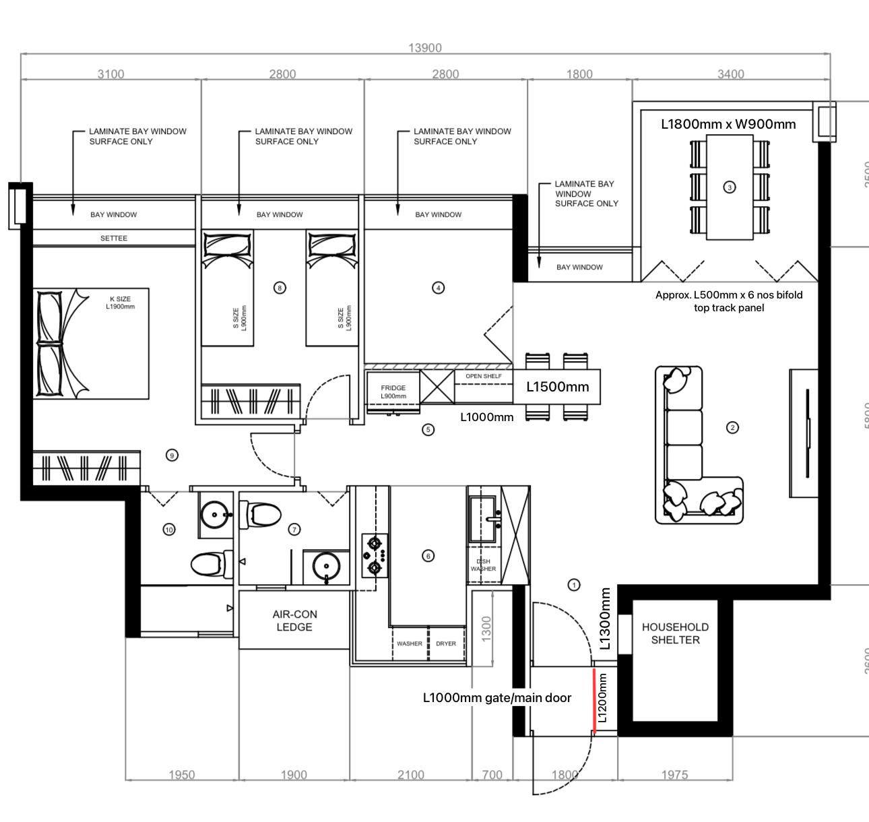
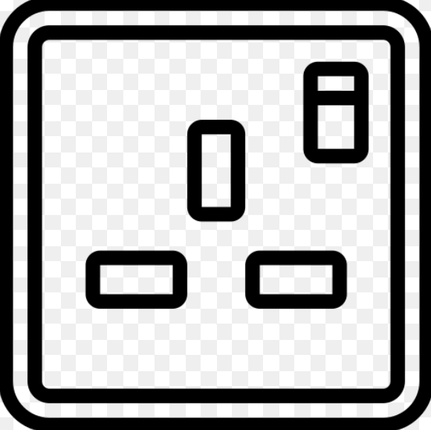
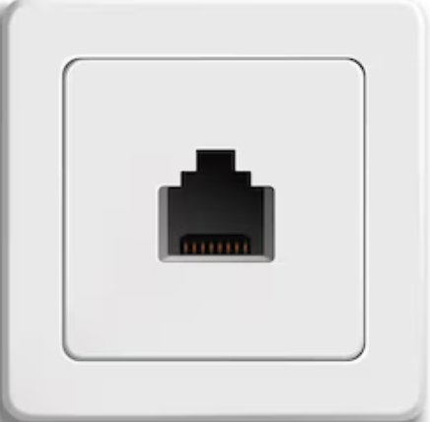
Network and Power Socket
1x (L)
1x (L)
3x
2x (L)
1x
1x
2x
2x
1x
2x (L)
3x
2x
3x
1x
Network Point
3x
2x
Power Point
1x (H)

Slide 2


Aircon and Fan
Aircon
Wall Mounted
Fan

Slide 3


Lighting

